Slide 1

GenAI: MSADS Website
Notes:
Liang

Slide 2

Our Team
Daichi Ishikawa
Liang Gong
Haoran Zheng
Notes:
Liang

Slide 3
Business Problem: MSADS Website
Current Problem
Expected Outcome
Students interested in the MSADS program often spend a lot of time searching for relevant information on a cluttered website.
Chatbot to find answers quicky
No budget seems to be allocated for hiring an external development team to implement this tool.
Midterm project for GenAI students
Notes:
Liang Business problem

Slide 4
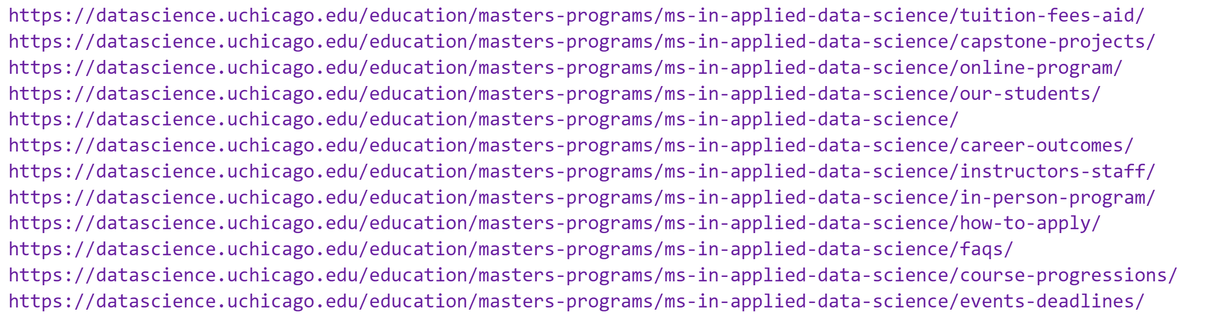
Website Review
The MS in Applied Data Science program at the University of Chicago prepares students with practical, hands-on data science skills, focusing on real-world applications. The program includes a comprehensive curriculum covering machine learning, data engineering, and data visualization, along with a capstone project for practical experience. The program’s expert faculty, strong industry connections, and career support services equip graduates for successful careers across various industries. The website provides information on the curriculum, faculty, admissions, career outcomes, and program formats (in-person and online).
Notes:
Liang

Slide 5
Project Overview
Objective: Develop a Retrieval-Augmented Generation (RAG) chatbot to provide instant, accurate answers to queries about the MS in Applied Data Science program, enhancing user understanding and engagement.
Scope: Create a conversational AI system that integrates both retrieval and generation capabilities.
- Answer detailed questions on program structure, admissions, courses, faculty, and career opportunities.
Key Components
1. Data Processing
- Tasks: Web scraping of program content, structuring and cleaning text.
- Outcome: Prepares consistent, high-quality data for retrieval.
2. RAG Implementation:
- Tasks: Generate and store embeddings in a vector database for efficient retrieval.
- Outcome: Enables quick access to contextually relevant data for each query.
3. LLM Integration:
- Tasks: Use GPT-4 or similar to provide dynamic, conversational answers.
- Outcome: Engages users with accurate and context-aware responses.
4. User Interface:
- Tasks: Build a Streamlit/Flask UI for seamless user interaction.
- Outcome: Provides a user-friendly platform for Q&A with real-time responses.
Deliverables:
- Functional RAG-based chatbot with detailed documentation.
- User-friendly interface and PowerPoint presentation.
- Evaluation metrics for retrieval accuracy and relevance.

Slide 6
Preprocessing Steps
Data Preprocessing and Vectorization (vectordb_creation.py)
Data Collection and Preprocessing
Fetching Web Content:
Function: fetch_web_content(url: str)
Retrieves raw HTML content from provided URLs using requests.
Handles SSL verification and timeouts for reliability.
Metadata Extraction:
Function: extract_metadata(url: str, html_content: str)
Extracts critical metadata such as:
title, keywords, description, author, and the domain.
Utilizes BeautifulSoup to parse and extract metadata from HTML.
Includes the page's fetch date to track when the data was collected.
Content Cleaning:
Function: clean_content(html_content: str)
Cleans and extracts the main content from HTML using trafilatura.
Ensures only the essential, readable content is retained, removing unnecessary HTML tags.

Slide 7
Preprocessing Steps
Data Preprocessing and Vectorization (vectordb_creation.py)
Document Creation and Chunking
Document Creation:
Function: create_document(url: str)
Combines metadata and cleaned content to create a structured Document object.
Stores URL, domain, and content type for further processing.
Document Splitting:
Function: split_document(doc: Document)
Uses RecursiveCharacterTextSplitter to split large documents into smaller, more manageable chunks (default 1000 characters, 200-character overlap).
Ensures that each chunk can be indexed and queried independently.
Chunk Metadata:
Adds metadata to each chunk, including:
chunk_index: The position of the chunk in the document.
total_chunks: Total number of chunks for reference.
chunk_size: The size of each chunk, useful for debugging and optimization.

Slide 8
Preprocessing Steps
Data Preprocessing and Vectorization (vectordb_creation.py)
Enhancing Metadata and Vectorization
Enhancing Metadata:
Function: enhance_metadata(documents: List[Document])
Enhances document metadata by parsing URL paths (e.g., /masters-programs/).
Extracts primary category and subcategory from URL to enrich metadata.
Adds human-readable page_type to indicate the document’s content type.
Embedding Initialization:
Function: init_embeddings(model: str = "text-embedding-3-small")
Initializes OpenAI’s embedding model (text-embedding-3-small by default) to convert documents into vectors for similarity search.
Vector Database Creation:
Function: create_and_save_vectordb(documents: List[Document])
Creates a FAISS vector database from the document embeddings.
Saves the FAISS vector store locally for efficient retrieval.
Benefits: Fast approximate nearest neighbor (ANN) search, ensuring quick document retrieval based on vector similarity.

Slide 9
Preprocessing Steps
Loading and Structuring the Vector Database (vector_search.py)
1. Loading the Vector Database
Function: load_vectordb(load_path, model="text-embedding-3-small")
Purpose: Loads FAISS vector database for efficient access to document embeddings.
Embedding Initialization: Uses OpenAI’s text-embedding-3-small for semantic vector generation.
Error Handling: Catches and logs errors during loading for robust system operation.
Parameterization: Allows flexible model choice and database path.
2. Performing Similarity Search
Function: search_similar_chunks(vectorstore, query, k=5, filter_dict=None)
Purpose: Retrieves top-k similar document chunks based on the user’s query.
Metadata Filtering: Optionally filters results by fields like primary_category, enhancing relevance.
Output: Returns a list of Document objects with content and metadata.

Slide 10
Preprocessing Steps
Loading and Structuring the Vector Database (vector_search.py)
3. Formatting Search Results
Function: format_chunk_results(documents, metadata_fields=None, include_content=True, max_content_length=None)
Purpose: Structures retrieved results for clear and readable output.
Customizable Display: Selects metadata fields (e.g., page_type, title) and limits content length for readability.
Importance: Improves user experience with well-organized, context-rich results.
4. Inspecting Metadata Fields
Function: inspect_metadata(vectorstore, sample_query="sample", sample_size=100)
Purpose: Analyzes unique metadata values to understand database structure.
Use Case: Identifies fields for effective filtering (e.g., categories), optimizing search relevance.
5. Example Usage and Testing
Test Queries: Demonstrates retrieval with example questions like “What are the core courses?”
Metadata Inspection: Reviews metadata distribution to aid in filter optimization.
Purpose: Validates retrieval pipeline and metadata filtering logic.

Slide 11
Model Architectures
OpenAI Embeddings for Semantic Encoding
Embedding Model:
Uses OpenAI’s text-embedding-3-small model to encode text data into high-dimensional vector embeddings.
Purpose: Converts documents and queries into vector representations that capture semantic meaning, allowing the system to perform similarity-based retrieval.
Role in Retrieval: Embeddings are stored in a FAISS vector database, enabling searches based on vector similarity, which improves retrieval relevance over keyword matching.
2. FAISS Vector Store for Efficient Similarity Search
FAISS (Facebook AI Similarity Search):
Serves as the vector database to store document embeddings, facilitating fast similarity-based retrieval.
Approximate Nearest Neighbor (ANN) Search:
FAISS uses ANN algorithms to perform efficient, high-dimensional vector searches, essential for large-scale databases.
Allows the retrieval of top-k similar documents based on user query embeddings.
Metadata Filtering:
Supports filtering by metadata (e.g., primary_category, subcategory), which helps refine searches to provide contextually relevant results.

Slide 12
Model Architectures
3. GPT-4 Language Model Chain for Response Generation
Chat Chain Initialization:
Function: create_chat_chain in chat_utils.py
Model: OpenAI’s gpt-4 model, configured for conversational AI.
Temperature Setting: Controls response variability, balancing creativity and relevance based on user needs.
Prompt Template:
A structured prompt guides the GPT-4 model to generate responses based on the retrieved context.
Context Integration:
Includes placeholders for context (retrieved document chunks) and question (user query).
Ensures that the model references specific documents and metadata fields in its responses, enhancing relevance.
Response Generation:
GPT-4 takes the structured prompt and retrieved chunks to generate a coherent, contextually accurate answer.
This design allows the chatbot to give specific, informed answers based on the user’s query and the retrieved content.

Slide 13
Model Architectures
4. Query Rewriting for Enhanced Retrieval
Function: rewrite_queries in chat_utils.py
Purpose: Uses GPT-based rephrasing to generate multiple variations of the user’s query.
Benefits:
Expands the scope of retrieval by rephrasing the query in different ways.
Increases the chance of finding relevant documents by capturing diverse expressions of the same intent.
5. Subcategory Detection for Targeted Filtering
Function: subcategory_finder in chat_utils.py
Purpose: Classifies the user’s question into specific subcategories to refine retrieval.
Metadata-Based Filtering: Helps the system to narrow down the search space by focusing on the most relevant subcategories, improving precision in the retrieval process.
6. Reciprocal Rank Fusion for Ranking Results
Function: reciprocal_rank_fusion in chat_utils.py
Purpose: Combines results from multiple query rephrases, scoring each document based on its rank across different query variations.
Benefit:
Merges results from diverse query formulations, allowing the system to prioritize the most relevant documents based on cumulative ranking.

Slide 14
System Design
System Overview and Data Flow
System Overview:
Integrates several key components: data preprocessing, embedding and vector storage, query handling, response generation, and user interface.
Components interact seamlessly to create an AI-powered information retrieval chatbot focused on UChicago’s MS in Applied Data Science program.
Data Flow:
User Query Input:
User submits a question through the Streamlit interface (main_streamlit.py).
Query Preprocessing:
The query is preprocessed, rewritten, and expanded using functions like rewrite_queries in chat_utils.py to improve retrieval.
Document Retrieval:
FAISS vector database (vector_search.py) performs similarity-based retrieval to find relevant document chunks.
Response Generation:
Retrieved chunks and user query are passed to the GPT-4 model (create_chat_chain in chat_utils.py) to generate a final response.
Response Display:
The response is displayed in the Streamlit interface, with conversational history maintained for continuity.

Slide 15
System Design
Core Components and Integration
1. Data Preprocessing and Vectorization:
Script: vectordb_creation.py
Key Functions:
fetch_web_content and extract_metadata for retrieving and processing data from UChicago’s website.
create_document and split_document to structure and chunk documents.
create_and_save_vectordb to generate and save the FAISS vector database with embeddings.
Purpose: Prepares data for efficient retrieval by structuring documents, enhancing metadata, and creating embeddings stored in FAISS.
2. Vector Database for Document Storage and Retrieval:
Library: FAISS (Facebook AI Similarity Search)
Script: vector_search.py
Functions:
load_vectordb loads the vector database with precomputed embeddings.
search_similar_chunks retrieves document chunks similar to the user query based on vector similarity.
Integration:
The vector database is structured to support fast similarity searches and metadata filtering, enabling targeted and efficient retrieval.
3. Language Model Chain for Response Generation:
Model: GPT-4, via OpenAI’s API
Script: chat_utils.py
Functions:
create_chat_chain initializes the model chain, with a structured prompt to integrate retrieved document chunks and query.
rewrite_queries and subcategory_finder improve the relevance of retrieved information.
Integration:
The language model chain takes the retrieved chunks and user question, using the context to generate a coherent and contextually accurate response.

Slide 16
System Design
User Interaction and Additional Functionalities
1. User Interface (Streamlit):
Script: main_streamlit.py
Purpose: Provides a simple and interactive UI for users to ask questions and view responses.
Key Elements:
Session State Management: st.session_state is used to track chat history (chat_history) and maintain the conversation flow (llm_chat_history).
Dynamic Input and Response Display:
User inputs are managed with text_input, and responses are displayed with a typing effect for a natural experience.
Toggle Mechanism for Input Reset:
Clears the input box after each interaction using st.session_state.clear_input, making it easier for users to enter new queries.
2. Conversational Memory Management:
Class: ChatHistory in chat_utils.py
Functionality:
Maintains the conversation history, enabling context to persist across multiple turns.
add_interaction and get_history methods allow tracking of user queries and responses, which are integrated into subsequent interactions.
Purpose: Ensures a seamless user experience by preserving context across multiple exchanges.
3. Result Ranking and Filtering:
Reciprocal Rank Fusion:
Function: reciprocal_rank_fusion in chat_utils.py
Merges results from multiple rephrased queries, ranking documents based on their cumulative relevance.
Metadata-Based Filtering:
Function: search_similar_chunks in vector_search.py with filter_dict support.
Filters results based on metadata fields (e.g., primary_category, subcategory) to improve the precision of retrievals.
Purpose: Enhances response quality by prioritizing the most relevant content through ranking and filtering mechanisms.

Slide 17
Key Challenges
Include both hyperlink text and URL in retrieve context
Ideal result: "For questions regarding an application fee waiver, you can refer to the Physical Sciences Division fee waiver policy https://physicalsciences.uchicago.edu/academics/admissions/application-requirements/#FeeWaiver. (Source: https://datascience.uchicago.edu/education/masters-programs/ms-in-applied-data-science/how-to-apply/)“
Right now: "For questions regarding an application fee waiver, you can refer to the Physical Sciences Division fee waiver policy. (Source: https://datascience.uchicago.edu/education/masters-programs/ms-in-applied-data-science/how-to-apply/)“
Tried BeautifulSoup, regex and embed the URL in metadata.
Maintaining Conversational Context:
Implementing a robust history tracking system to retain context across multiple queries within a session.
Notes:
Liang
This encourages the generated image to not only match the pixel values of the input image but also to have similar high-level features, leading to more visually appealing and realistic results.
By integrating perceptual loss, the model not only focuses on minimizing pixel-wise differences but also ensures that the generated images have similar high-level features to the input images.
This leads to better quality and more realistic generated images.

Slide 18
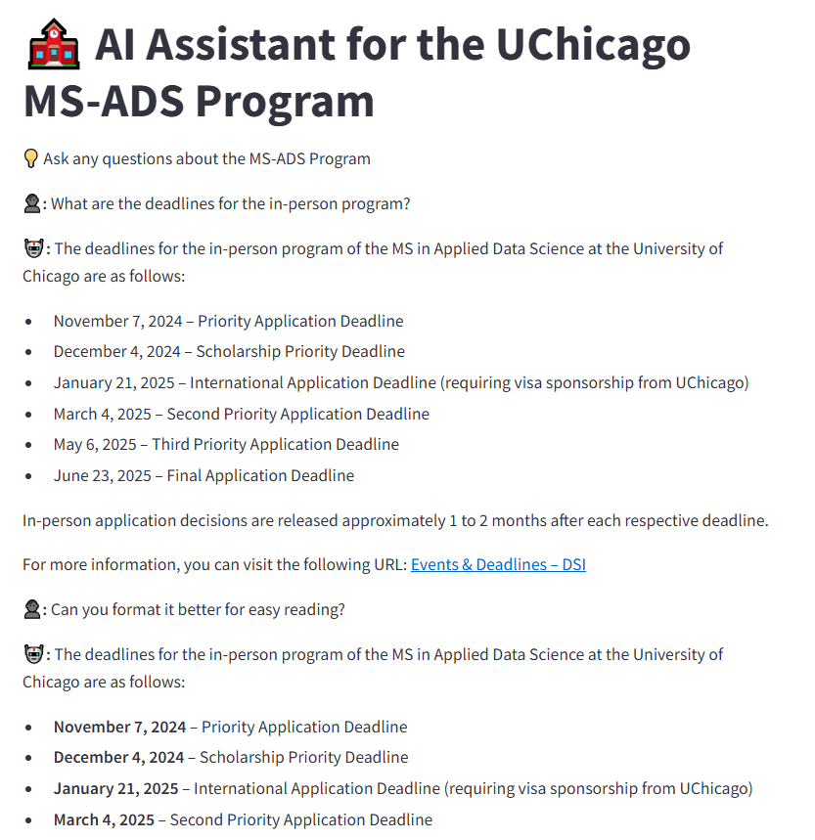
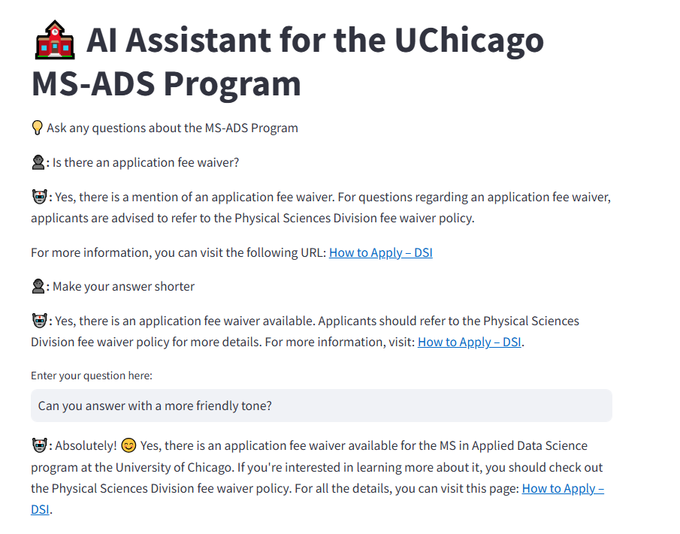
Response Relevance
Notes:
text-to-image generative model

Slide 19
Evaluation Metrics
Notes:
text-to-image generative model

Slide 20
Future Improvements
Expanded Metadata and Contextual Cues:
Include additional metadata fields (e.g., content freshness, user intent) to enhance filtering accuracy.
Automated Evaluation Metrics:
Develop automated relevance scoring metrics to evaluate and monitor response quality over time.
User Personalization:
Tailor responses based on user history or preferences to enhance engagement and relevance.
Upgrade to More Advanced Embedding Models:
Experiment with newer or more specialized embedding models as they become available to improve
retrieval precision.

Slide 21
Conclusion
PAY US FOR THIS TREMENDOUS WORK!

